Slide 1


Step 1: Select relevant dataset
Peng Jiang
Cancer Data Science Lab, National Cancer Institute
Tuesday, March 3, 2020

Slide 2
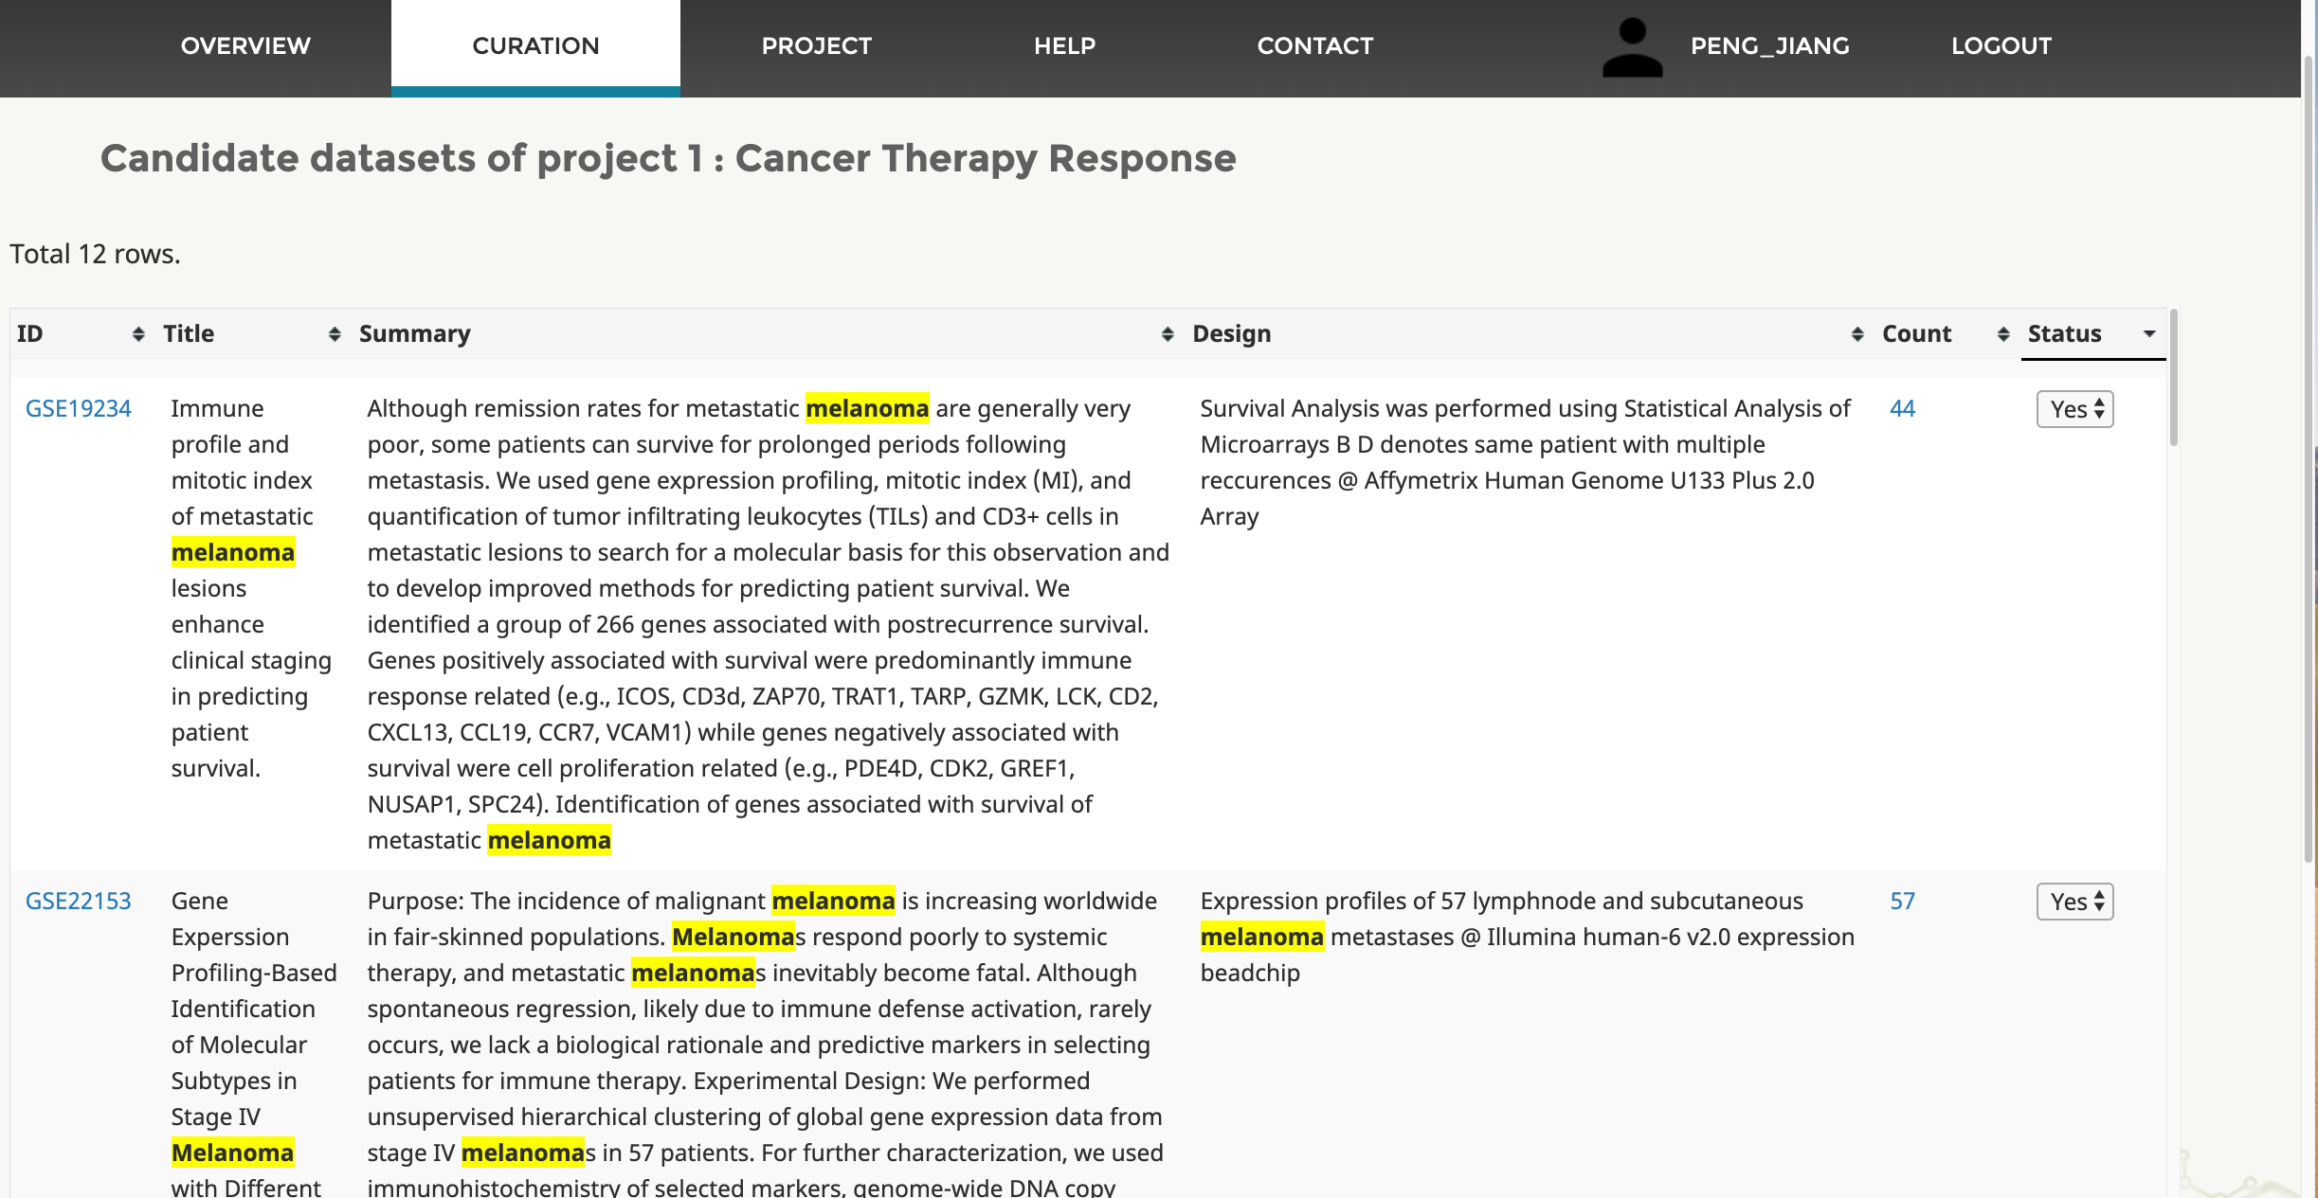
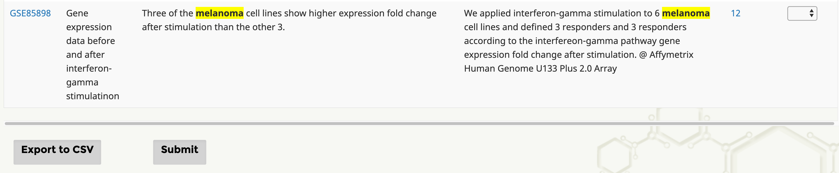
1
7c
3
2
5
6
7a
4
5
6
Other datasets in the middle ... ...
5
6
8
9
7b

Slide 3
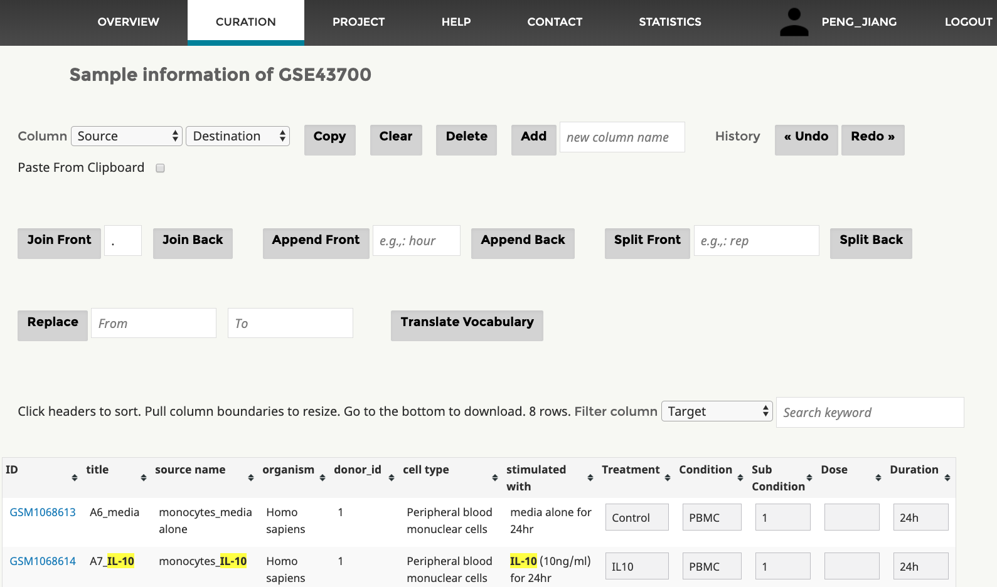
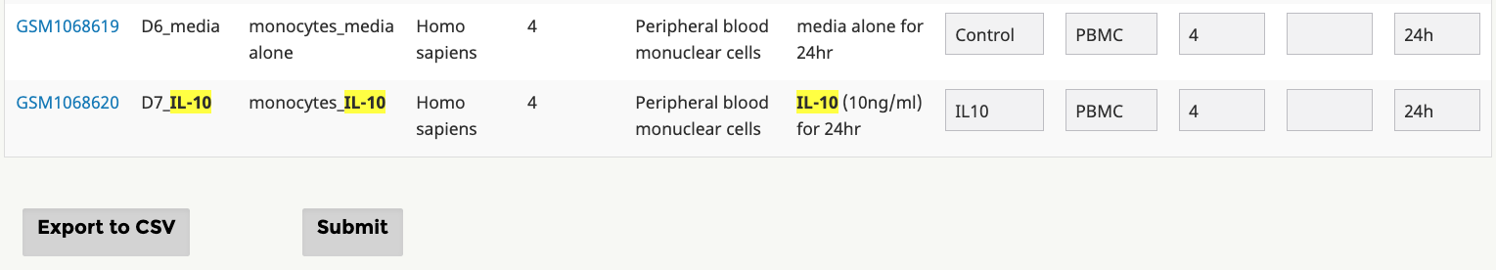
1
2a
3
4
5
6
2b
7
8
9
11
10
Source Columns
Destination Columns
Other samples in the middle ... ...

Slide 4
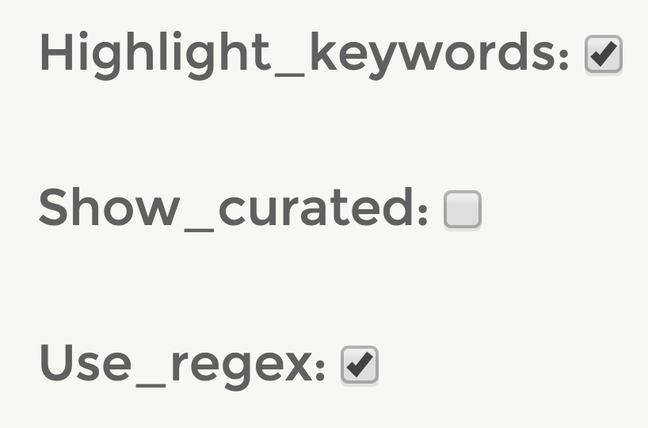
1
2
3

